Slide 1
ON-line Spending Habits: Describing Behavior is Easier Than Predicting It!
Jolene Branch DSC680: Applied Data Science Bellevue University July 25, 2021
Notes:
https://screenrec.com/share/REMvuKZ7Sf

Slide 2
Table of Contents
Purpose and Questions to Answer
Data Sources
Methods
Answers
Conclusions
Resources

Slide 3

Questions to Answer
“Can linear regression be used to predict if I will purchase something based on either one of two derived variables?
“How much % off does a textbook have to be for me to buy it new?”
“Am I more likely to purchase a book NEW if it is a more recent release?”
“Can Amazon predict how many home deliveries will be required in a month?”
“Hypothesis: I’m willing to pay for shipping if I can get a great deal (such as for a used book)?”

Slide 4
Questions to Answer
“Are there product category purchases that we 'hide' from each other by using a gift card or reward points?”
“Does Shipment Date correspond with Delivery Date (which isn't a variable)? Because even though my purchases outnumber those of my husband by about 3 to 1, I try and have them all delivered on my Prime day.”
“Who is the ‘better’ customer? (by rate of returns) Were returned items not as good of deals? (Can Amazon use that understanding to predict return rates?)”
“Are item prices normally distributed?”
“Who orders the more expensive items?”

Slide 5


Data Sources
Three datasets from Amazon.com
Six files total (1of each dataset for 2 spouses)
.xlxs files
36 columns, 2035 rows
Notes:
The datasets were in the form of .xlsx files retrieved using the ‘Download order reports’ selection under ‘Ordering and shopping preferences’ of both spouse’s accounts. (Vasdev, 2017).
One dataset contained items ordered, date, shipping location and recipient, condition, list price, purchase price, payment type.
Another contained shipping dates by date ordered and item.
A third contained information on returns, of which there were surprisingly few. All were converted to .csv format and imported into R using read.csv. The original file contained 36 columns and 2035 rows.

Slide 6
Methods
Data from ‘all time’ to ensure enough for predictive modeling
Prep and cleaning of data using Excel and R
Outlier ‘correction’
Change to Python to work with irregular time series
Notes:
Prep and cleaning of data using Excel and R
De-identification
Removal of unnecessary variables
Derived variable creation
Unique identifier
Outlier ‘correction’ - . Fifty-nine items had purchase price higher than list price. Also, some list prices were entered as $0.00.
IF formula
Items missing the item name but containing all other data points were retained
9 rows with ItemTotal $0.00 were deleted. All belonged to the husband.

Slide 7
Time Series Modeling Attempts
Date conversion challenges and an irregular time series produced unexpected obstacles in using R for predictive modeling.

Slide 8
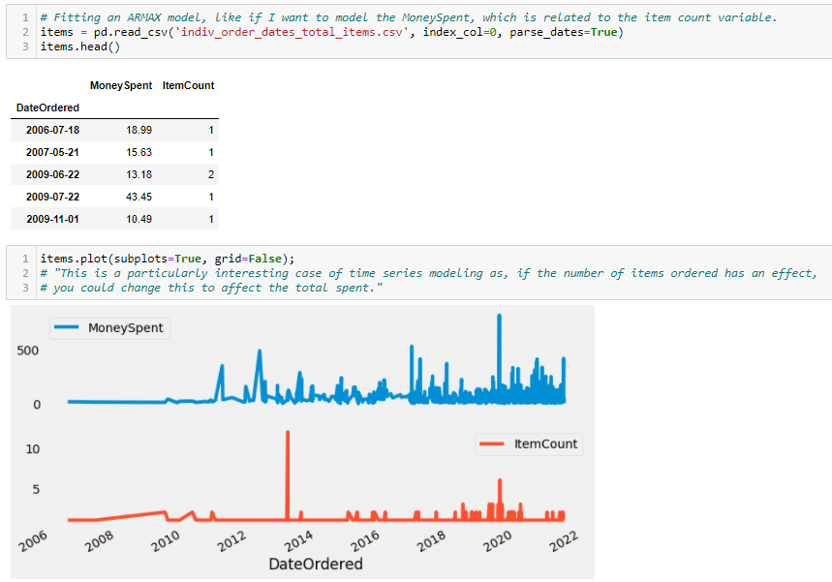
Time Series Modeling Attempts
Python proved to be more manageable at time series modeling.
Yet the irregular date index still presented obstacles.
Notes:
From https://stackoverflow.com/questions/58510659/error-valuewarning-a-date-index-has-been-provided-but-it-has-no-associated-fr

Slide 9
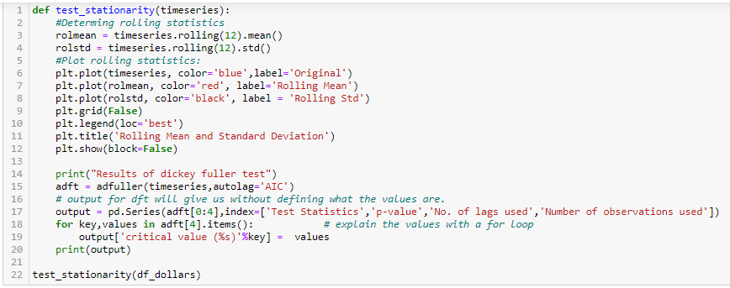
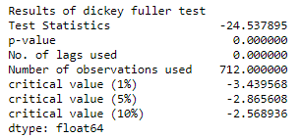
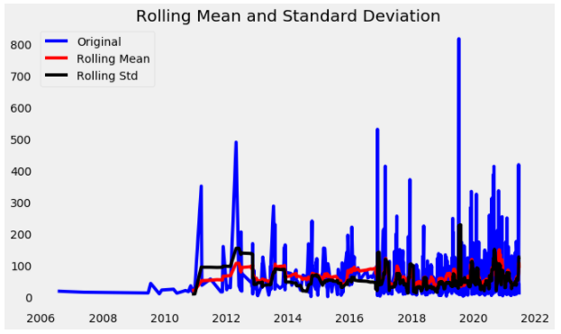
The p-value is < 0.05, so we can reject the Null hypothesis. The data has a unit root. Also, the test statistic is NOT greater than the critical values. The dataset is stationary.
I believe this means that I do not need to do a seasonality decomposition or separate trend from the series in order to make it stationary.
Notes:
from https://www.kdnuggets.com/2020/01/stock-market-forecasting-time-series-analysis.html
First, we need to check if a series is stationary or not because time series analysis only works with stationary data.
ADF (Augmented Dickey-Fuller) Test
The Dickey-Fuller test is one of the most popular statistical tests. It can be used to determine the presence of unit root in the series, and hence help us understand if the series is stationary or not. The null and alternate hypothesis of this test is:
Null Hypothesis: The series has a unit root (value of a =1)
Alternate Hypothesis: The series has no unit root.
If we fail to reject the null hypothesis, we can say that the series is non-stationary. This means that the series can be linear or difference stationary.
If both mean and standard deviation are flat lines(constant mean and constant variance), the series becomes stationary.
So let's check for stationarity:

Slide 10
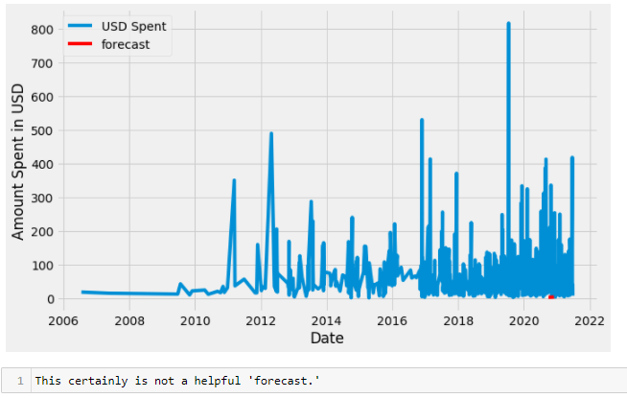
SARIMAX Results

Slide 11
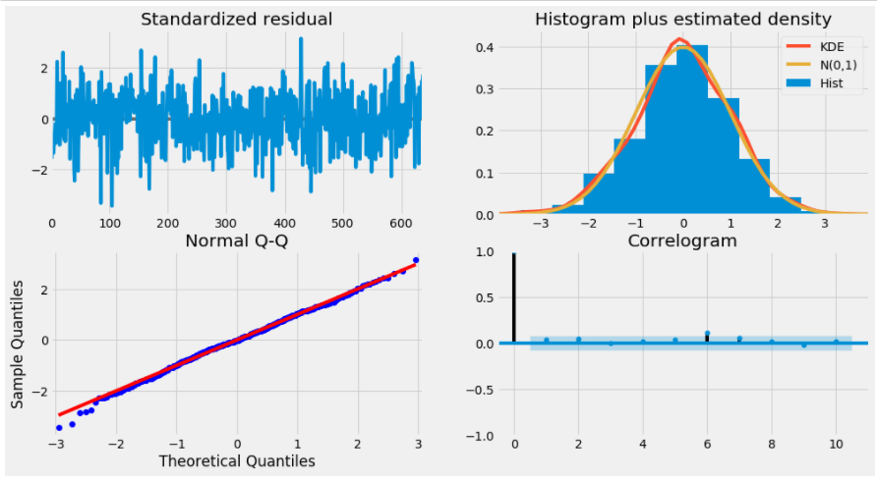
ARIMA Results
Notes:
What do these mean? (explanations from https://www.kdnuggets.com/2020/01/stock-market-forecasting-time-series-analysis.html)
Top left: The residual errors seem to fluctuate around a mean of zero and have a uniform variance.
Top Right: The density plot suggest normal distribution with mean zero.
Bottom left: All the dots should fall perfectly in line with the red line. Any significant deviations would imply the distribution is skewed.
Bottom Right: The Correlogram, aka, ACF plot shows the residual errors are not autocorrelated. Any autocorrelation would imply that there is some pattern in the residual errors which are not explained in the model. So you will need to look for more X’s (predictors) to the model.
Overall, it seems to be a good fit.

Slide 12
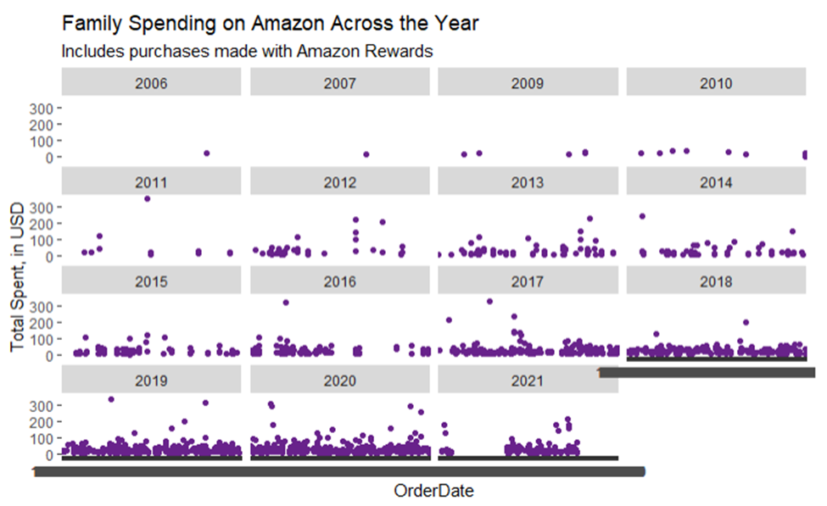
What is going on here? Post-COVID vaccine availability ‘shop in person’ phenomena?
Notes:
What is going on here? Why would both spouses abruptly stop ordering goods on-line for several months?
Is this an error in Amazon’s dataset? Or ‘COVID effect’?

Slide 13
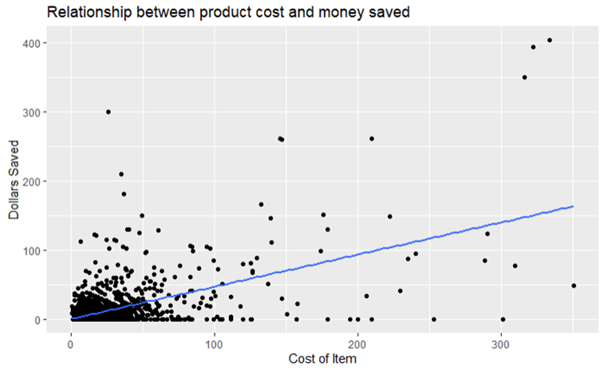
“Can linear regression be used to predict if I will purchase something based on either one of two derived variables?
It appears that there is a positive correlation between the Cost of Item and Dollars Saved. However, the strength of relationship weakens as the Cost of Item increases due to small number of instances at the higher price levels.

Slide 14
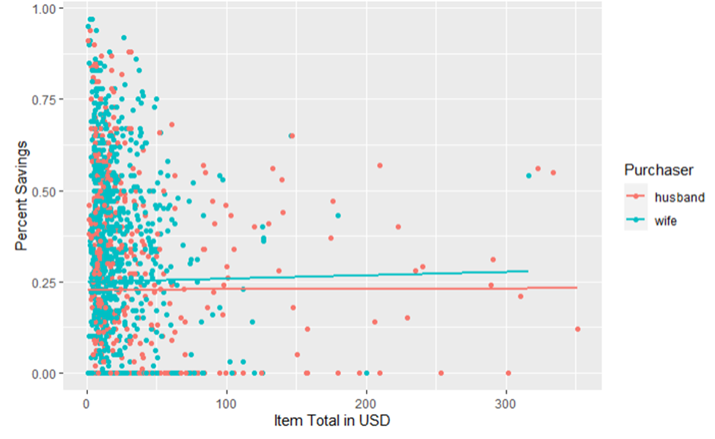
This (low n at high dollar amounts) might also be skewing an Item Total and Percent Savings chart, subsetted by spouse.

Slide 15
“How much % off does a textbook have to be for me to buy it new?” “Am I more likely to purchase a book NEW if it is a more recent release?”
Amazon no longer provides this information in individual’s ‘Order History.’
Notes:
Having purchased about half of the textbooks for a graduate program used but seeing only one used book purchase listed in recent months leads to the unfortunate conclusion that Amazon no longer tracks the condition of the books that it sells through outside vendors or itself. This results in an inability to predict purchase of a used book based on date of publication or purchase price.
This is interesting. I did not notice when initially reviewing the dataset, that the ‘condition’ of books purchased was no longer being recorded. That is surprising, given that data storage is cheaper than ever and Amazon already had the processes in place by which to store the data.

Slide 16
“Can Amazon predict how many home deliveries will be required in a month?”
ShipmentDate versus ReceiptDate
Rural deliveries – too expensive?
Retail space purchases – future pick up locations for delivery abusers?
PROBABLY!
Notes:
This is likely the case, however, the ShipmentDate is only a proxy variable for the ReceiptDate.
If people like my husband use Prime to have everything delivered ASAP, will there be a renegotiation of contract terms needed at some point? It might not be worth it for Amazon to send things to our rural home three days a week.

Slide 17
“Hypothesis: I’m willing to pay for shipping if I can get a great deal (such as for a used book)?”
Data no longer provided in ‘Order History’ data pulls
This does NOT mean that Amazon cannot predict my purchase of a used book based on data of publication or purchase price!
Notes:
While I can’t easily pull this data, I bet Amazon can (because they used to provide it to customers).

Slide 18
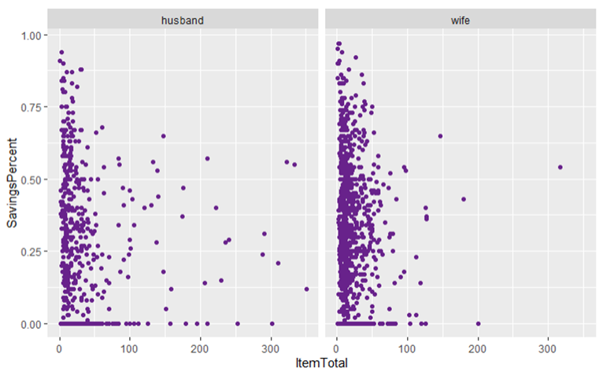
“Are there product category purchases that we 'hide' from each other by using a gift card or reward points?”
No such pattern was found. However, an interesting finding of very few items costing more than $100 being ordered by the wife indicates that at least one of the married couple remembered their pre-marital agreement to always check with the other prior to any item purchase of over $100.
Notes:
In his defense, the husband likely did talk with the wife prior to making the purchases!

Slide 19
“Does Shipment Date correspond with Delivery Date (which isn't a variable)? Because even though my purchases outnumber those of my husband by about 3 to 1, I try and have them all delivered on my Prime day.”
Yes, these two variables correspond, but have random variation even within themselves.

Slide 20
“Who is the ‘better’ customer? (by rate of returns) Were returned items not as good of deals? (Can Amazon use that understanding to predict return rates?)”
Neither spouse had enough items returned to attempt to use this variable for prediction modeling.
It is likely that Amazon is keeping an eye on return rates, though. (Do, 2020) (Rubin, 2018)
Notes:
Interestingly, the husband, who had about 1/3 of the purchases of the wife, had more returns. A future action could be to calculate the return rate for the husband and search for additional detailed accounts of users being cancelled due to ‘excessive’ return histories.
Rubin noted that the cancellation of his Amazon Prime membership was not permanent. (Rubin, 2018).
The numbers were so few that there was no benefit anticipated from joining that dataset with the other two.

Slide 21
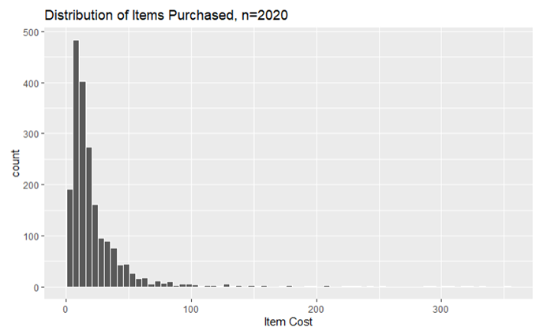
“Are item prices normally distributed?”
No. The distribution of items by price shows a right skew. The mean is greater than the median. The high-cost outliers contribute to this effect.
High-cost outliers

Slide 22
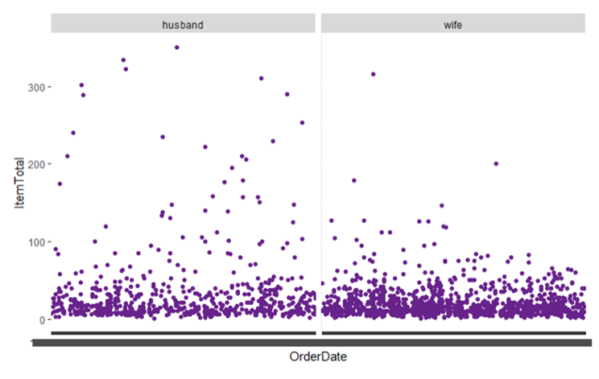
“Who orders the more expensive items?”
While the wife ordered about three times as many items, the number of items that cost more than $100 was at least two times more apparent within the husband’s data.

Slide 23
Conclusion
Based on the very close linear regression line of percent off purchases between the husband and the wife, it is unlikely that a prediction model would find much predictive power in the difference between the spouses, but with multiple regression based on category and cost or purchase, it is possible that this could be done in the general sense for the whole family unit.
Delivery and return costs cut into profit margins. A model that takes user/customer data and warns them when they are in danger of being ‘cancelled’ by Amazon is going to be needed.
Notes:
Due to the unsuccessful attempts to wrangle this irregular time series data within R in manner to be useful for modeling, the descriptive nature of this data is all that can be used to make inferences of future behavior.

Slide 24
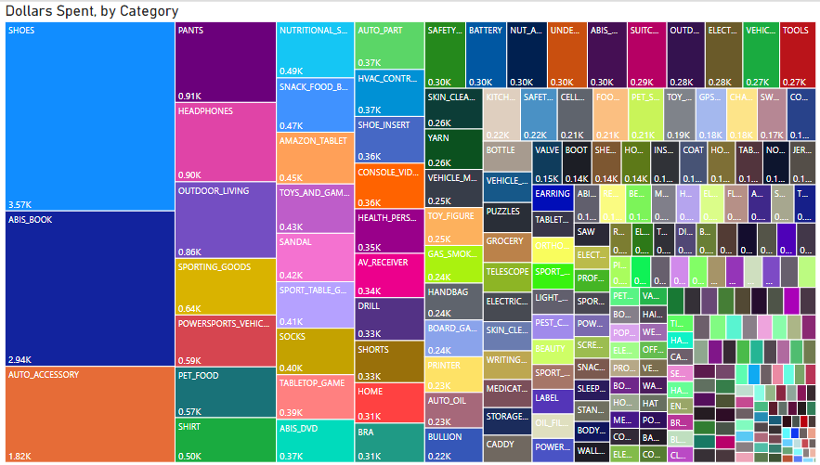
Notes:
That shoes and books are the two named categories is not a surprise, as that is how the company got its start, and it has had many years to perfect the business model.
Source: Power BI, Amazon Dollars Spent, by Category

Slide 25
References
Choudhury, A. (2021, March 28). Top 10 Python Tools For Time Series Analysis. Analytics India Magazine. https://analyticsindiamag.com/top-10-python-tools-for-time-series-analysis/
Custer, C. (2021, June 9). How Much Have You Spent on Amazon? Analyzing Amazon Data. Dataquest. https://www.dataquest.io/blog/how-much-spent-amazon-data-analysis/
Do, T. (2020, November 18). Return too many items on Amazon? Will Amazon Ban your Account? TechWalls. https://www.techwalls.com/amazon-ban-return-too-many-items/
Editors, T. (2021, April 26). The 100 Best Shopping Sites to Browse Through. Marie Claire. https://www.marieclaire.com/fashion/g1898/best-online-shopping/
Federal Trade Commission. (2021, May 1). Online Shopping. Consumer Information. https://www.consumer.ftc.gov/articles/online-shopping
Ganley, M. (2021, April 2). How to check the total amount you've ever spent on Amazon. KSAT. https://www.ksat.com/features/2021/04/02/how-to-check-the-total-amount-youve-ever-spent-on-amazon/
Hartmans, A. (2021, July 2). Jeff Bezos originally wanted to name Amazon 'Cadabra,' and 14 other little-known facts about the early days of the e-commerce giant. Business Insider. https://www.businessinsider.com/jeff-bezos-amazon-history-facts-2017-4
Jusoh, Z. M., & Ling, G. H. (2012). Factors Influencing Consumers' Attitude Towards E-Commerce Purchases Through Online Shopping. International Journal of Humanities and Social Science, 2(4), 223–230.
Muenchen, B. (2017, March 23). The impact of R's dplyr package and its tidyverse companion packages on R's learning difficulty. r4stats.com | Data Science Services. http://r4stats.com/2017/03/23/the-tidyverse-curse/

Slide 26
References
Rubin, B. F. (2018, May 25). Amazon banned this shopper. Then he outsmarted them. CNET. https://www.cnet.com/tech/services-and-software/amazon-banned-this-shopper-then-he-outsmarted-them/
Safdari, N. (2018, December 2). If You Can't Measure It, You Can't Improve It !!! Medium. https://towardsdatascience.com/if-you-cant-measure-it-you-can-t-improve-it-5c059014faad
Sapegina, S. (2018, March 29). STDS Vignette : Regression Modelling with Time Series Data in R. http://rstudio-pubs-static.s3.amazonaws.com/374830_ab4ac8951c94411aa9abfe5f561cef91.html
Shork, J. (n.d.). R ggplot2 Error: Discrete Value Supplied to Continuous Scale (2 Examples). Statistics Globe. https://statisticsglobe.com/error-discrete-value-supplied-to-continuous-scale-in-r
Spend Analysis 101: Comprehensive Guide for Beginners. Sievo. (n.d.). https://sievo.com/resources/spend-analysis-101
Team, T. I. (2021, June 23). The Pros and Cons of Buying on Amazon. Investopedia. https://www.investopedia.com/articles/personal-finance/070215/how-buying-amazoncom-works.asp
Vasdev, S. (2017, May 15). How to find and visualize your Amazon order history data (Tutorial). TechChange. https://www.techchange.org/2017/05/15/how-to-find-and-visualize-your-amazon-order-history-data-tutorial/
Wang, J. (2020, April 8). How To Model Time Series Data With Linear Regression. Medium. https://towardsdatascience.com/how-to-model-time-series-data-with-linear-regression-cd94d1d901c0

